Slide 1

UNITING OUR PROFESSION
September 8 - 11, 2024 Indianapolis, IN

Slide 2

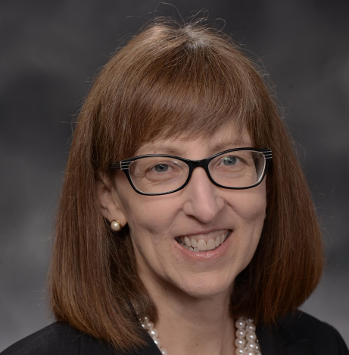



Operational Improvement Through Turnaround Time Management
KAREN BOEGER
Director
State of Missouri
BRENT DIXON
Assistant Director
State of Missouri
MICHAEL STROUD
Research and Data Analyst
State of Missouri
Notes:
We hope that you can take these ideas back home and experience that same success that we have.

Slide 3
Presentation Overview
Purpose
To discuss the transformation of operations from day-to-day transactional chaos to strategic data-driven management.
Importance
Turnaround Time Management provides a vantage point to orient and guide your operations.

Slide 4
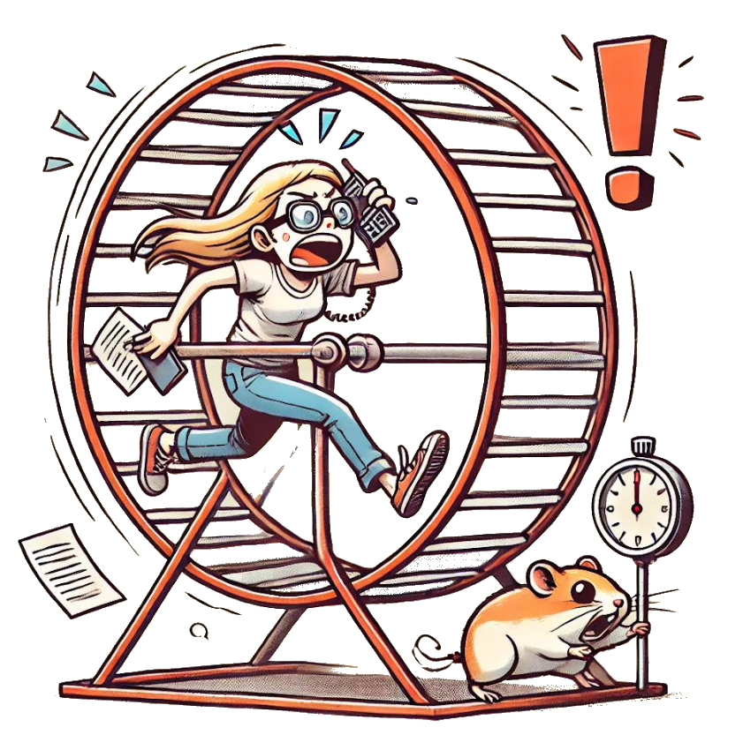
The Hamster Wheel Problem
What is procurement’s Hamster Wheel?
The relentless cycle of tasks that blinds and entraps procurement offices in a perpetual state of urgency!
Stifles opportunity for innovation or process improvement.
Notes:
What if we could get off the hamster wheel, and start to actually make some headway?

Slide 5


Making Headway With Tools
Missouri opted for these tools because...
Easy to use
Nominally expensive
State of Missouri standard
Smartsheet is an online spreadsheet that records procurements and informs buyers.
Tableau is a data visualization app that displays operational metrics and guides meetings.
Notes:
Smartsheet Lets us self manage our everyday and reminds us of deadlines
Tableau allows us to dig in deep and display analysis and trends.

Slide 6

Getting off the Wheel with Turnaround Time Management
Define bid types, bid phases, turnaround time goals
Measure the five data fields
(1) Assign to buyer date, (2) Completion date of each phase, (3) Final award date (4) Goal date for each phase, (5) Overall goal date
Analyze to communicate the important trends through color coding
Improve operations by placing analysis in the buyer’s routine
Control by managing through weekly analysis meetings
Notes:
Im going to go really fast through this section, and refer people to the paper.
In response to “encouragement” from customers for quicker bids, Missouri Purchasing closely examined its bid awarding process of drafting, issuance, and evaluation.
Three bid types were categorized and given turnaround time goals representing their complexity: IFB, RFP<$250,000, and RFP>$250,000.
Are you measuring these data?
B.2 Phase Splits in Racing

Slide 7
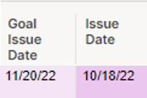
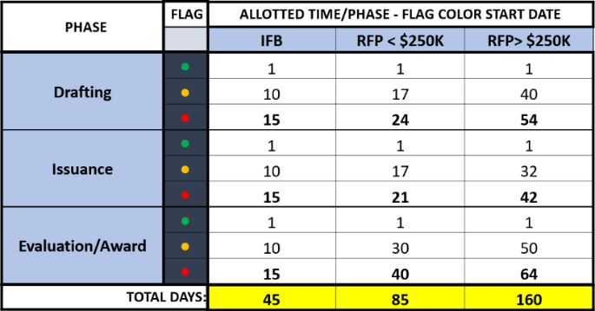
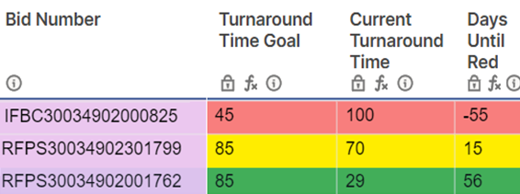
Color Coding Tasks
Color-coding readily indicates turnaround time performance:
Green for swift completion
Yellow as a limit warning
Red for exceeding goal turnaround times
Notes:
We use color-coding to readily indicate turnaround time performance: green for swift completion, yellow as a limit warning, and red for exceeding goal turnaround times.
We can’t see late bids, but Colors are something we can see.

Slide 8
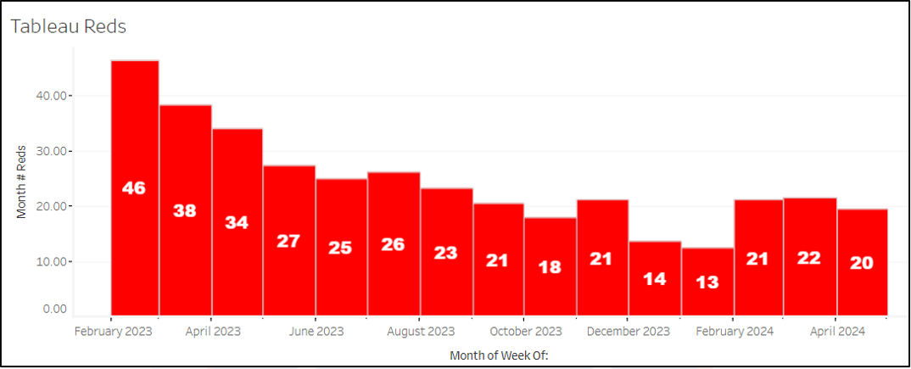
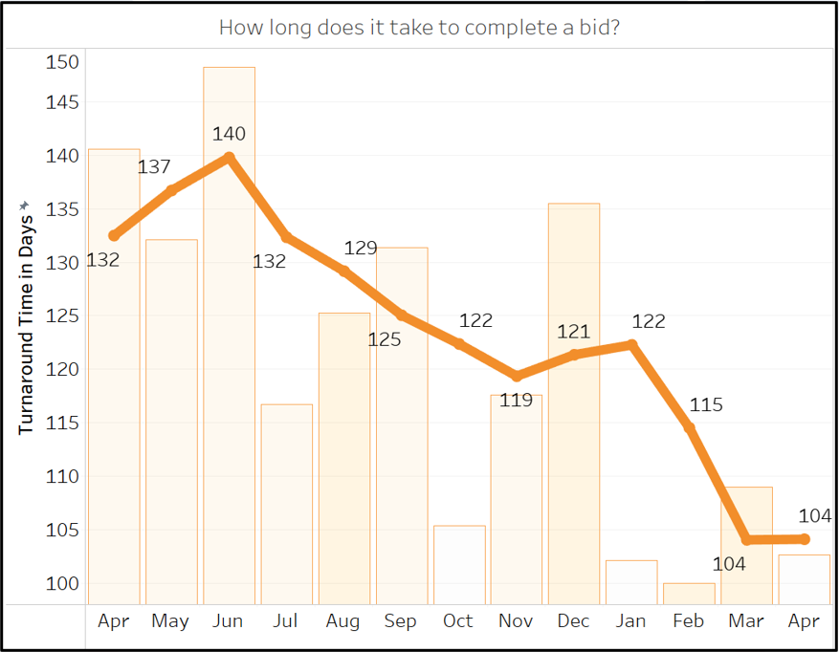
It really helped us a lot! (and it can help YOU)
Creating a spirit of competitive positivity inspired real change in our team
Service Improvement
Dissatisfied customers* decreased by 62%!
Efficiency
Turnaround time decreased by 31.4%!
*procurements behind turnaround time goals

Slide 9
Conclusion
Action
Missouri Purchasing created a turnaround time management process using color, which transformed our procurement operations from day-to-day transactional chaos to strategic data-driven management
Results
Turnaround Time Management provides remarkable service improvement and increased efficiency.

Slide 10

UNITING OUR PROFESSION
September 8 - 11, 2024 Indianapolis, IN

